Slide 1
Comparison of Supervised Machine Learning Models for Stellar Classification
Tópicos de Aprendizagem Automática – Project 1
Pétia Georgieva
Artur Correia – 102477
Daniel Carvalho - 77036

Slide 2
Table of contents
01
02
03
04
05
06
Context of the Problem
Machine Learning Models
Data Set Analysis and Preprocessing
Conclusions
Experimental Setup
Results and Analysis
2

Slide 3
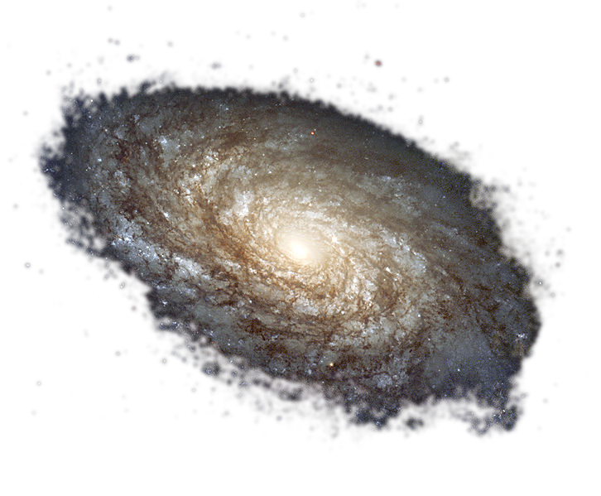
01
Context of the Problem
3

Slide 4
Context
The dataset analyzed in this project was the Sloan Digital Sky Survey Data Release 17 (SDSS DR 17)
Project funded by the Astrophysical Research Consortium
Focused on the spectroscopical analysis of celestial bodies, for the mapping of galaxy, black holes and the study of cosmological evolution
SDSS DR 17 focus on the classification of bodies as either Stars, Galaxies or Quasars
4

Slide 5
Related Work
“Stellar Classification by Machine Learning”, Zhuliang Qi, 2022
“Stellar Objects Classification Using Supervised Machine Learning Techniques”, Omat et al., 2022
“Stars & Galaxies: EDA and Classification” – Kaggle Project
“Stellar Classification - 98.4% Acc 100% AUC” – Kaggle Project
No hyperparameter tuning
No balancing of the data, or questionable data pre processing
Use of Random Forest and SVM models for training
High performance metrics (Accuracies of 97-98%)
5

Slide 6
Goals
Validation of the models present in related work
Use of extra models – Logistic Regression, Neural Network and XG Boost
Hyper parameter tuning and our own data pre processing
6

Slide 7
02
Dataset Analysis and Pre Processing
7

Slide 8
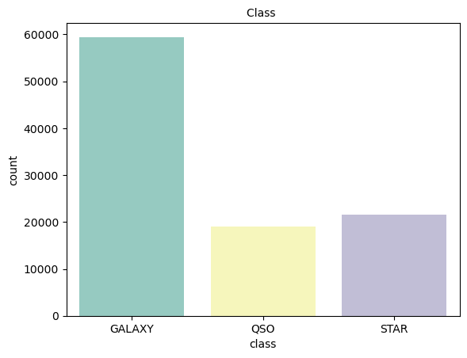
First Look
100,000 observations
17 features
Class column with 3 categories: star, galaxy, quasar
8

Slide 9
Features Context and analysis
Identification Purposes | obj ID, run ID, rereun ID, cam col, field ID, spec obj ID, plate, MJD, and fiber ID
Celestial Position | alpha and delta
Photometric measures | u, g, i, r and z
Distance | redshift
Not needed
9

Slide 10
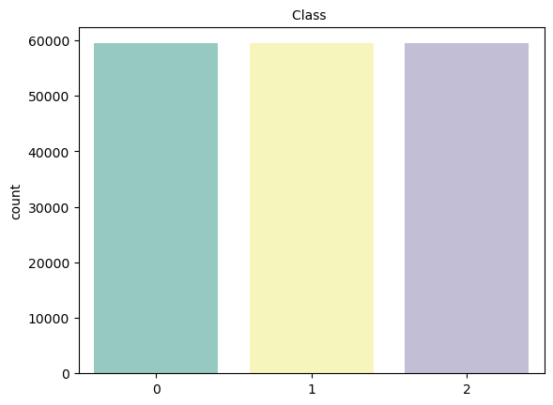
Balancing the data
SMOTE
10

Slide 11
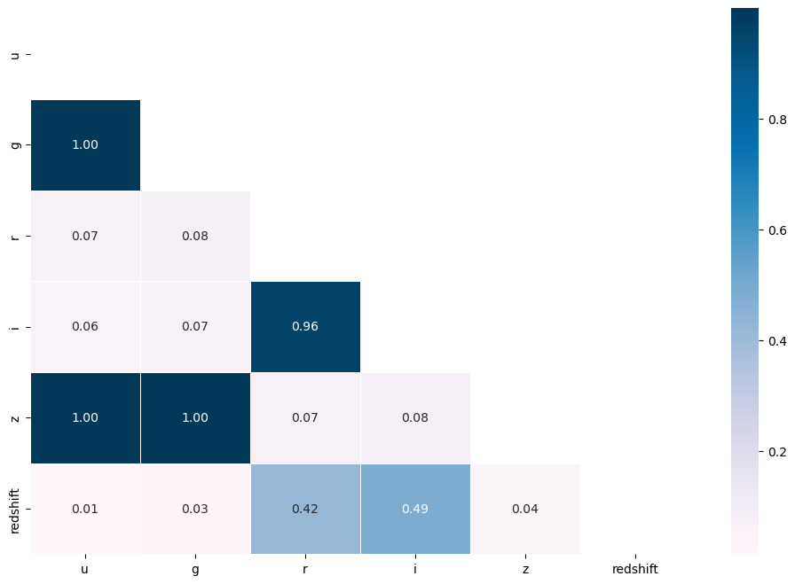
Feature Relation
The u, g and z features were very similar, so we decided to drop u and z.
11

Slide 12
Final features
g | Green filter in the photometric system
r | Red filter in the photometric system
i | Near-infrared filter in the photometric system
redshift | Redshift value based on the increase in wavelength
12

Slide 13
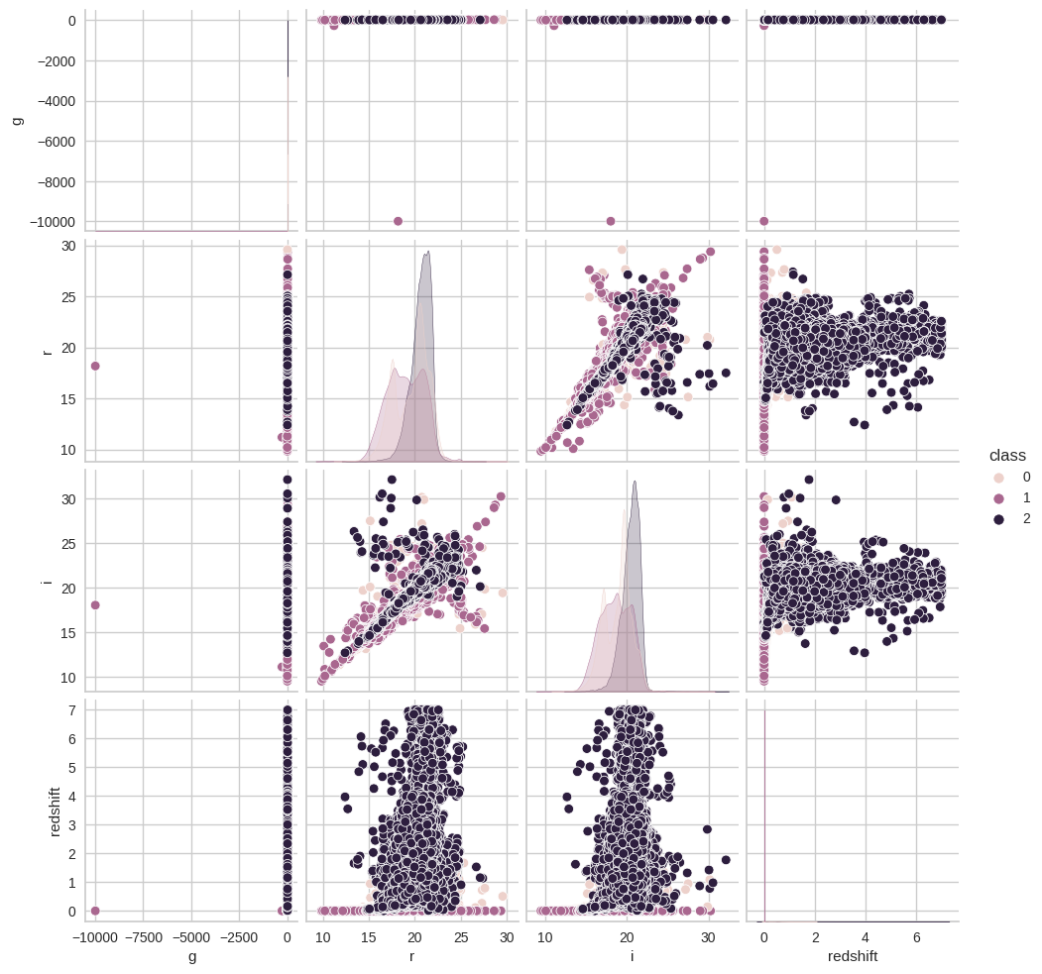
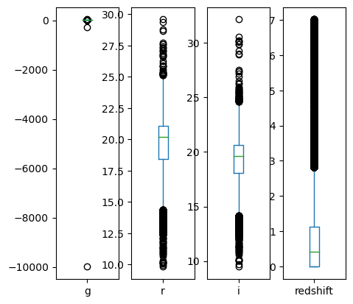
Data analysis
13

Slide 14
Data analysis (I)
There were distinct outliers that significantly affected the data visualization, therefore we decided to eliminate them using Interquartile Range (IQR) method
Any data points falling below Q1 - 1.5 * IQR or above Q3 + 1.5 * IQR are considered outliers.
14

Slide 15
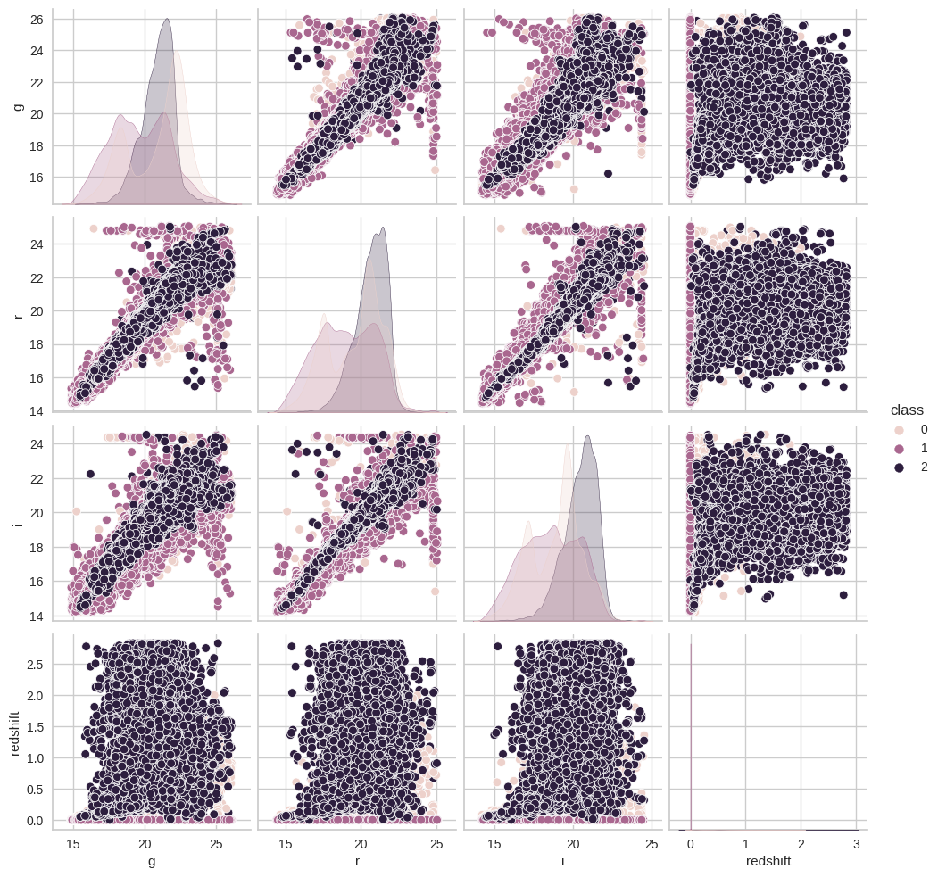
Data analysis (II)
We observed a significant overlap between the quasar class (2) and both the galaxy class (0) and the star class (1) in the plot.
15

Slide 16
Data normalization
We applied the standard scaler from the scikit-learn library
z = (x − μ) / σ
where z represents the standard score (or z-score) of a sample, x is the original value of the sample, μ is the mean (average) of the feature, and σ is the standard deviation from the mean.
16

Slide 17
03
Machine Learning Models
17

Slide 18
Models used
01
02
03
04
05
SVC (SVM)
XG Boost
Logistic Regression
Random Forest
MLPClassifier (Neural Network)
18

Slide 19
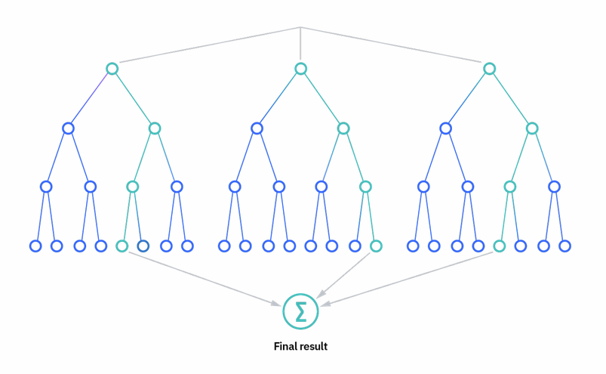
More about Random Forest & XG Boost
Random Forest uses bagging to execute parallel decision trees and the decision is an average
XG Boost uses the errors from the previous decision tree to create new ones.
19

Slide 20
04
Experimental Setup
20

Slide 21
Setup timeline
Train the models using the best hyperparameters
Initial training using default parameters
Optimal Model Training
Initial Training
Hyper-Parameter Tunning
Grid search method with a set of hyperparameters
Performance Evaluation
Compare performance between the models
21

Slide 22
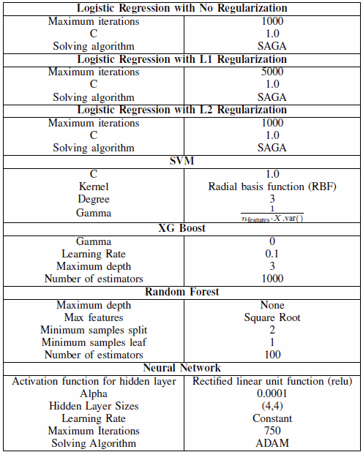
Initial model training
Used default parameters from the libraries
The exception being Logistic Regression, since L1 regularization needed more iterations to converge
22

Slide 23
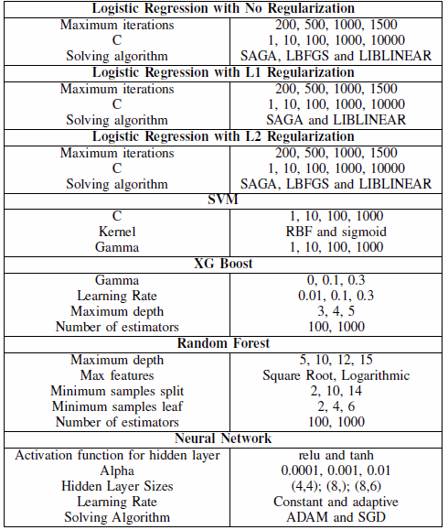
Hyper-Parameter Tuning
Grid Search K-fold cross validation technique using sklearn GridSearchSV class
Predefined set of Hyper-Parameters selected from research
23

Slide 24
Performance Evaluation Metrics
Accuracy
Recall
Precision
F1-Score
Balanced Accuracy
ROC curve
Precision-Recal curve
Class Prediction Error
24

Slide 25
05
Results and Analysis
25

Slide 26
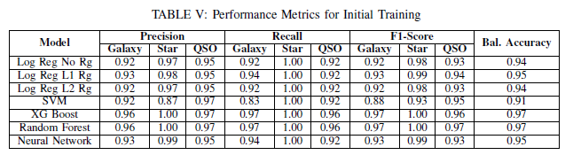
Initial Training Results
Worst Model
Best
Models
The classification of Stars had better metrics, when compared with Galaxies and Quasars, across all models
26

Slide 27
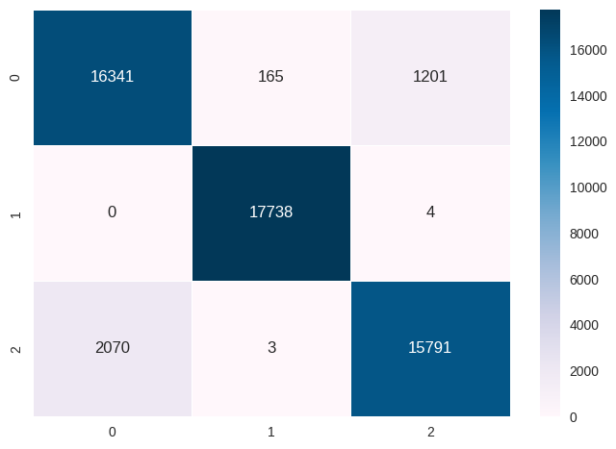


Confusion Matrixes After Hyperparameter Tuning
Logistic Regression with no Regularization
Logistic Regression with L1 Regularization
Logistic Regression with L2 Regularization
27
Notes:
Verdadeiros positivos

Slide 28
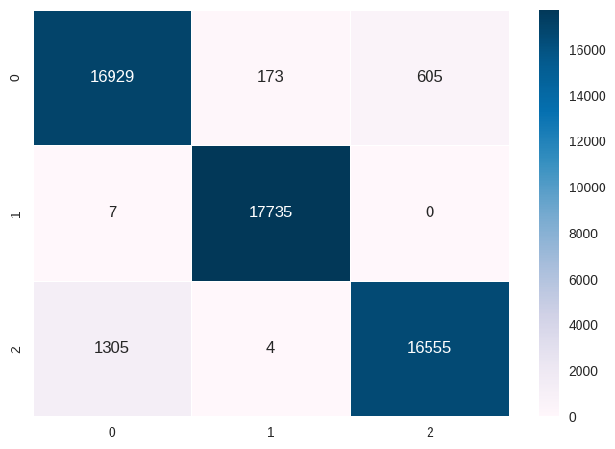
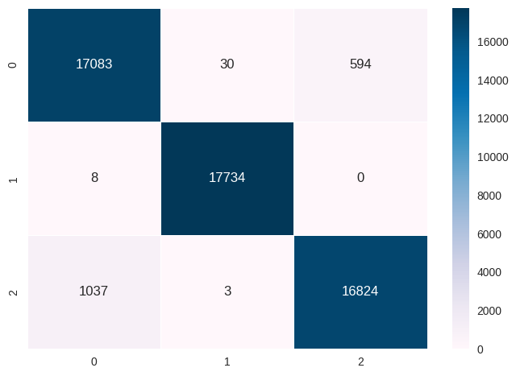


SVM
Random Forest
XG Boost
Neural Network
28

Slide 29
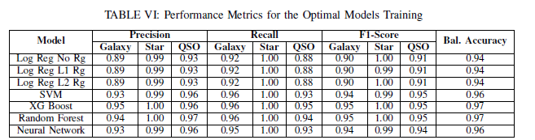
Training Results After Hyperparameter Tuning
Best
Models
Once again, the classification of Stars had better metrics, with the classification of Galaxies and Quasars slightly worsening
SVM had the biggest increase in performance, from a balanced accuracy of 91% to 96%
29
Notes:
Regressões Logisticas mantém valores XG Boost e Random Forest tamb+em Rede Neuronal sobre de 95% para 96% e SVM de 91% para 96% Precisão, Recall e F1-Score desceram para Galáxias e Quasares, comparando com antes do hyperparameter tuning

Slide 30
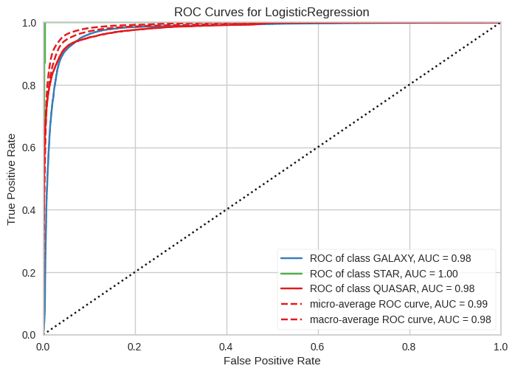


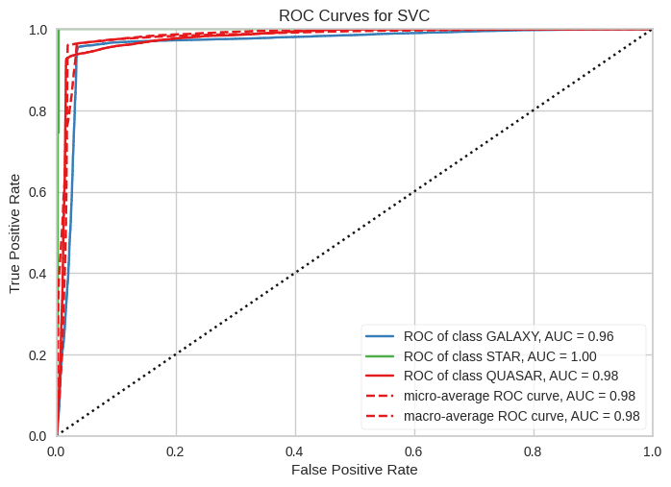
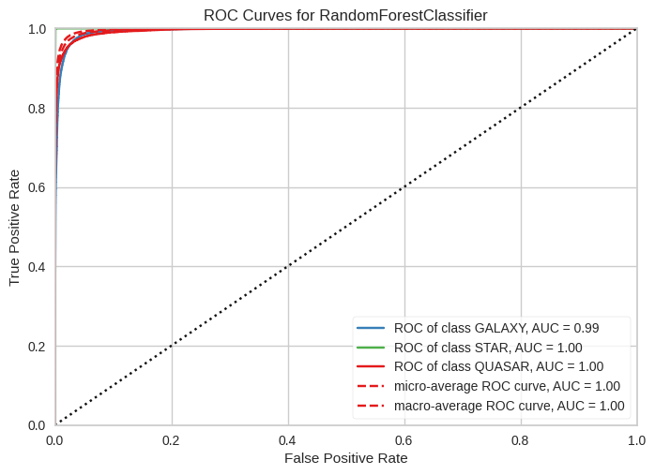
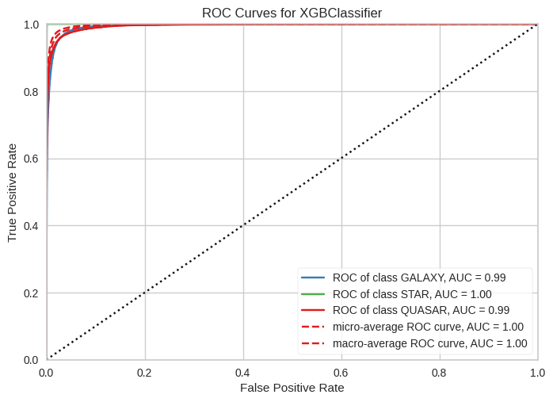
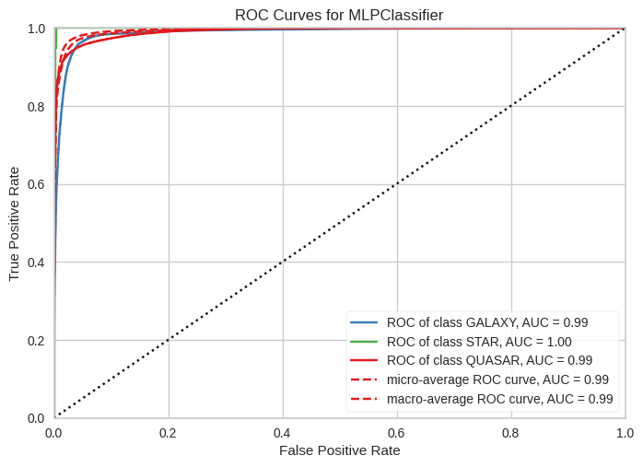
ROC Curves After Hyperparameter Tuning
Logistic Regression with no Regularization
Logistic Regression with L1 Regularization
Logistic Regression with L2 Regularization
SVM
Random Forest
XG Boost
Neural Network
30
Notes:
Altas taxas de verdadeiros positivos; baixas taxas de falsos positivos
Marca 100% AUC

Slide 31
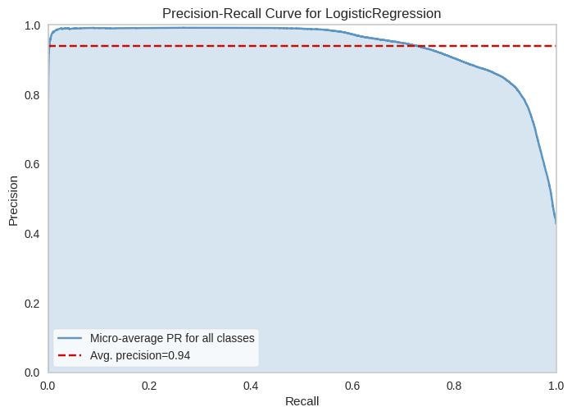


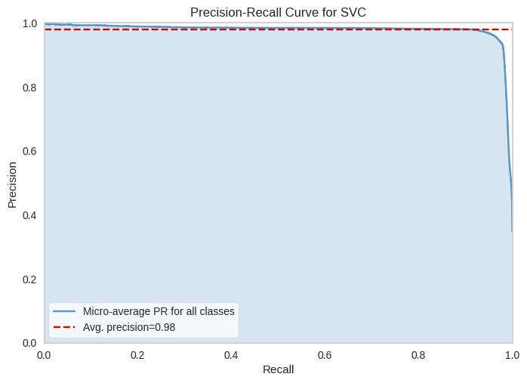
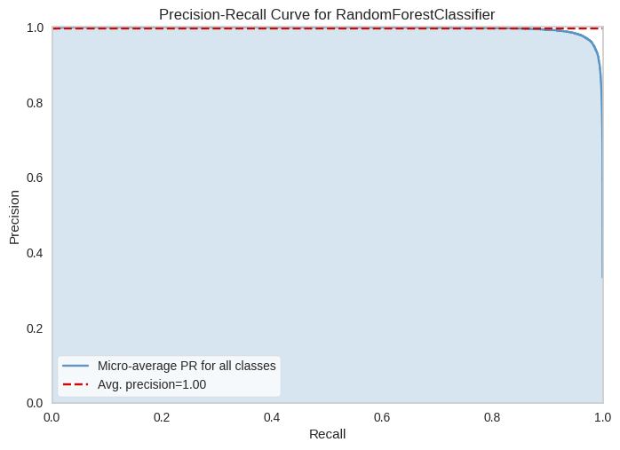
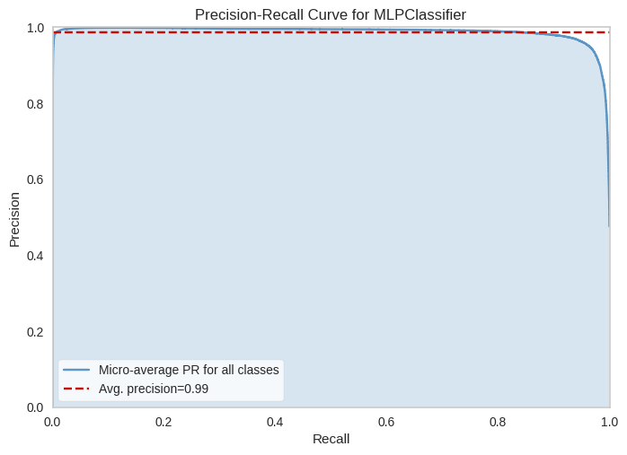
Precision Recall Curves After Hyperparameter Tuning
Logistic Regression with no Regularization
Logistic Regression with L1 Regularization
Logistic Regression with L2 Regularization
SVM
Random Forest
Neural Network
31
Notes:
Altas taxas de Recall, identificando exemplos positivamente, enquanto mantém a precisão também elevada

Slide 32
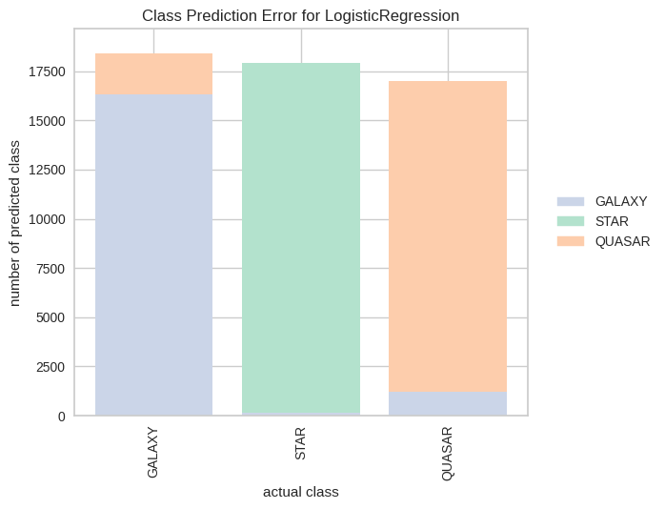

Class Prediction Error After Hyperparameter Tuning
Logistic Regression with no Regularization
Logistic Regression with L1 Regularization
Logistic Regression with L2 Regularization
Misclassification happens between the Quasar and Galaxy classes
32

Slide 33
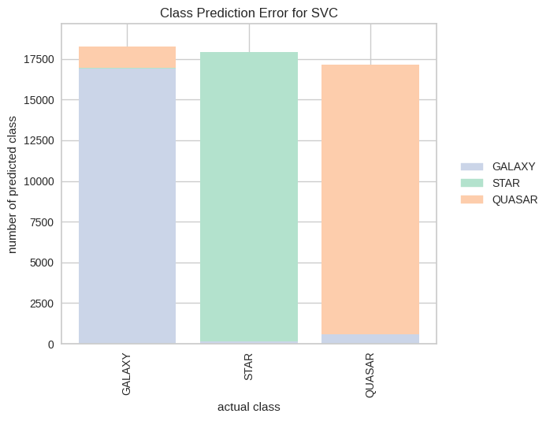
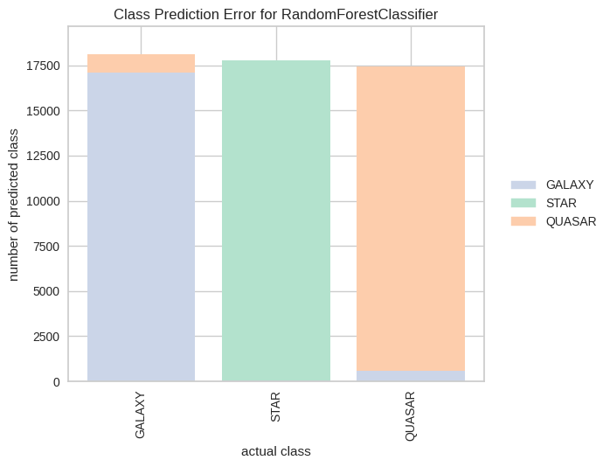
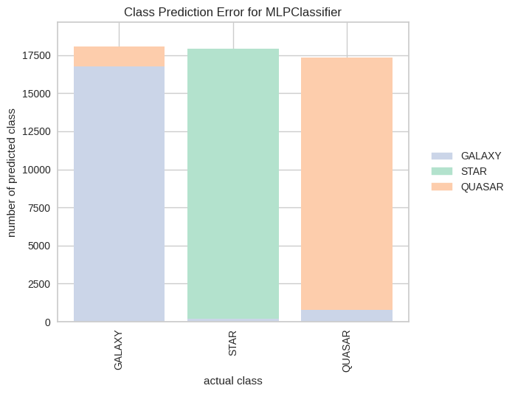
Class Prediction Error After Hyperparameter Tuning
SVM
Random Forest
Neural Network
Misclassification happens between the Quasar and Galaxy classes
33

Slide 34
06
Conclusions
34

Slide 35
Overall Results
All models obtained satisfactory results in all performance metrics, including balanced accuracy values of 94%+ and good ROC curves and AUC values
XG Boost and Random Forest consistently had better results, with 97% balanced accuracy and 95%+ values for all Recall, F1-Score and Precision scores
All models classify Stars examples nearly perfectly, while having more confusion between the Galaxy and Quasar classes
35

Slide 36
Hyperparameter Tuning
Hyperparameter Tuning wasn’t as efficient in increasing the performance of the models as we hoped
Only Neural Network, and in particular SVM, increased in performance
Possible overfitting of data
Not enough variety in the interval of values tested for hyperparameter optimization
36

Slide 37
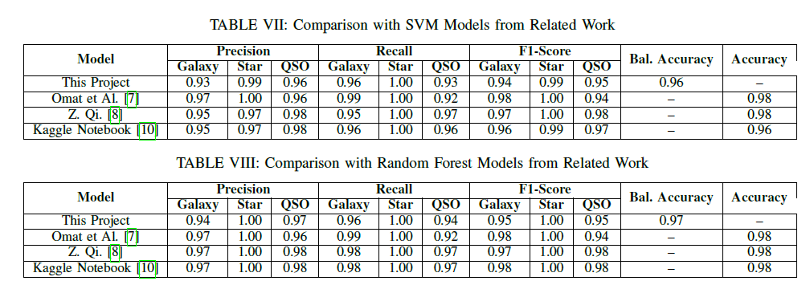
Comparison with Related Work
37
Notes:
As nossas conclusões corroboram os resultados obtidos por estes, tendo-se verificado que os modelos de Random Forest foram, também, mais eficazes nestes projetos, e que a classificação das Estrelas foi sempre mais eficiente, comparativamente com a das Galáxias e dos Quasares.
Verifica-se também que a nossa aposta no XG Boost foi certeira, pois foi o único modelo capaz de consistentemente competir com os valores de métricas obtidas pelo Random Forest.
De facto, nós recomendamos o uso do XG Boost, porque não só é eficaz, como é mais eficiente, tendo um tempo de execução muito reduzido comparado aos outros modelos.

Slide 38
Thanks!
Please keep this slide for attribution
38

